Slide 1
Lost & Found system
Python final project
Wang Tian kun 2430036131
Li Rong pu 2430036061
Li Ru dong 2430036062
Ye Ting xuan 2330024283

Slide 2
Contants
CONTANTS
1
Problems generated by chatbot
2
Solutions of each task
3
Example

Slide 3
1
Problems generated by chatbot

Slide 4
Problems description
UIC would like to implement a Lost&Found System for our campus.
Task No. 1 to 7 are required. If they are well implemented, it is enough to give you 100/100
Task 1: Exception Handling Identify and handle basic exceptions in the existing code to ensure the system runs smoothly. For example: Handle errors when reading or writing to files (e.g., files do not exist or are corrupted). Validate user inputs to ensure they are meaningful and within the expected format.
Task 2: Implement Key Methods Complete the implementation for the following methods:
report_item(): Allows a user to report a lost item. The item should be added to the system with a "Lost" status.
find_item(): Allows a user to report a found item. The item should be updated with a "Found" status in the system.
remove_item(): Allows an administrator to remove an item from the system.
display_items(): Displays all unreturned items in the system, showing only key details (e.g., name, location, and status).
Task 3: When a user reports a lost item or finds an item, their username should be recorded. Update the user_scores.csv file to maintain a score for each user. For example: Reporting a lost item: +5 points. Finding an item: +10 points.

Slide 5
Problems description
Task 4: Unique Identifiers Modify the Item class to include a unique identifier (unique_id) for each item. This will prevent conflicts when multiple items with the same name and location exist.
Task 5: Scoreboard Implement a scoreboard() method that displays all users and their scores in descending order. This will allow the library to recognize and reward active participants.
Task 6: Advanced Console Interaction Design and implement a simple console-based interface for interacting with the system. This interface should:Allow users to report lost or found items. Allow administrators to view and manage the item inventory. Display the user scoreboard.
Task7：The LibraryItem class and LibraryLostSystem class allow for managing the status of lost items, including the ability to record the name of the finder. The system supports updating the item's status when it is found, capturing the finder’s name, and reflecting these changes in the CSV file.

Slide 6
2
Solution of each task

Slide 7
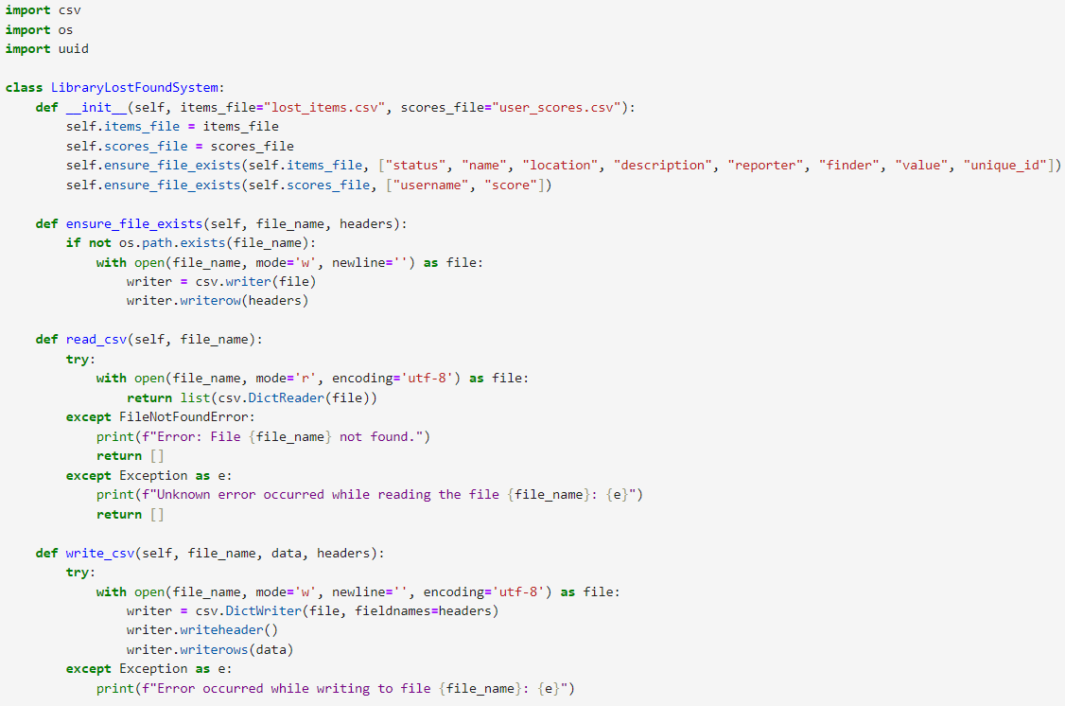
Task1
Handle basic exceptions in the existing code to ensure the system runs smoothly. For example: Handle errors when reading or writing to files (e.g., files do not exist or are corrupted). Validate user inputs to ensure they are meaningful and within the expected format.
Firstly, it imports: `csv` for working with CSV files, `os` to interact with the operating system regarding file existence, and `uuid` to generate unique identifiers.
The `LibraryLostFoundSystem` class use an `__init__` method to take two file names as parameters (with defaults) and sets them as attributes.
Then it calls `ensure_file_exists` to make sure the relevant files are there.
It checks if a file exists and creates it with given headers if not.
The `read_csv` method attempts to read a CSV file.
If found, it returns the data as a list; otherwise, it handles errors and may return an empty list.
The `write_csv` method tries to write data to a CSV file, including writing headers and rows, and also deals with potential errors.

Slide 8
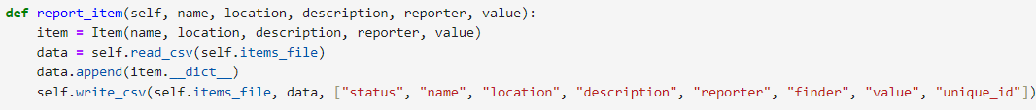
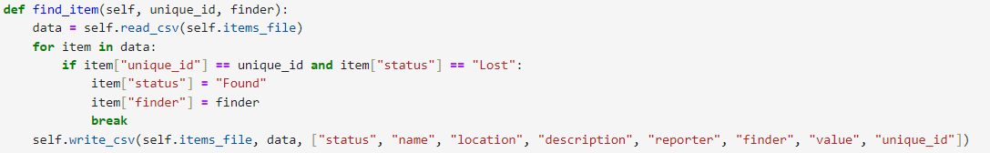
Task2
report_item(): Allows a user to report a lost item. The item should be added to the system with a "Lost" status.
It first creates an 'Item' class and let users to input information. Then call the 'read_csv' method to read the data in the CSV file and add the newly reported item information. Finally, the 'write_csv' method is called to write the updated item information list back to the CSV file.
find_item(): Allows a user to report a found item. The item should be updated with a "Found" status in the system.
First,use ‘read_csv' method to get a list of all the item information. Then go through the list of each item information dictionary.When the item's ' unique_id ' and the number input are the same, and its status is "Lost" , it change the status of the item to "found".Also make a note of the ' finder ,and then jump out of the loop. Finally, the 'write_csv' method is called to write the updated item information back to the CSV file.

Slide 9
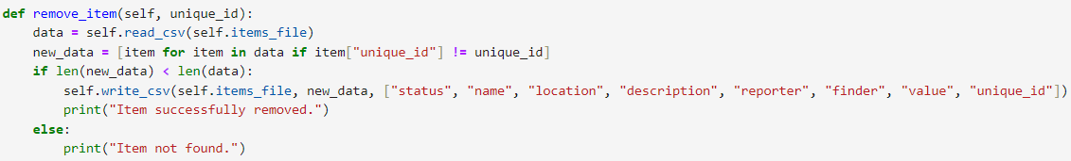
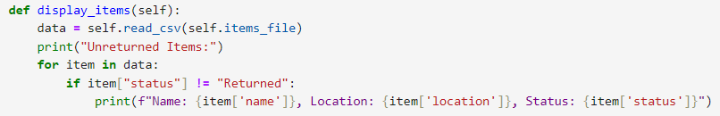
Task2
remove_item(): Allows an administrator to remove an item from the system.
First,use ‘read_csv' method to get a list of all the item information. Then use the list derivation to create a new list 'new_data'(contains only those items whose unique number is different from the number passed to remove, equivalent to filtering out the information about the item to be removed)
Then compare the length of the new list and the original list. If the new list length is shorter than the original, indicating that there are indeed items removed, then call the 'write_csv' method to write the new list of items back to the CSV file, and print a successful removal message. If length are the same, print a message that the item is not found.
display_items(): Displays all unreturned items in the system, showing only key details (e.g., name, location, and status).
It reads the contents of the CSV file for the item information, and then prints a header "Unreturned Items:" to show the unreturned items.
Then iterate through all the items. For those whose status isn't "Returned," print out their name, location, and status so you can see what hasn't been returned.

Slide 10
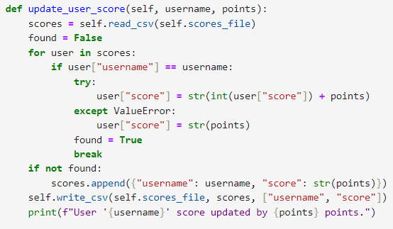
Task3
When a user reports a lost item or finds an item, their username should be recorded. Update the user_scores.csv file to maintain a score for each user. For example: Reporting a lost item: +5 points. Finding an item: +10 points..
It first reads CSV file and gets a list of all the information. Then set a 'found' variable to 'False', which is used to flag whether the corresponding user is found.
Then go through each user information dictionary in this list, when find (' username ') and the passed username is consistent with the user, increase the (' points'), Turn it into a string and save it back.
When the user is found, set the 'Found' variable to 'True' and exit the loop. If no user is found, a new dictionary containing the user name and credits is added to the list of user credits. Finally, call the 'write_csv' method to write the updated user integral information back to the CSV file, and print out the user integral update prompt information.
If a 'ValueError' exception occurs when converting integers (for example, the original integral is not a valid numeric format), the passed integral points are converted directly into a string and stored back as a new integral.

Slide 11
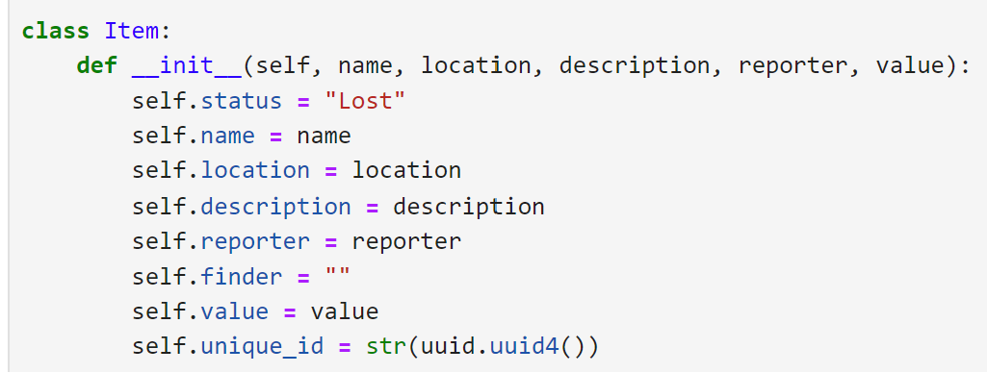
Task4
Unique Identifiers Modify the Item class to include a unique identifier (unique_id) for each item. This will prevent conflicts when multiple items with the same name and location exist.
#2 The class's initializer (constructor), which is called automatically when a new instance of the Item class is created. It also accepts the following parameters.
#3 Set a attribute called status for the instance, indicating the state of item is lost.
#10 Generate a unique identifier (UUID) for the instance and assign it as a string to the unique_id attribute.
The 'uuid' module generates Universally Unique identifiers, which are used in the code to generate a unique number for each item.

Slide 12
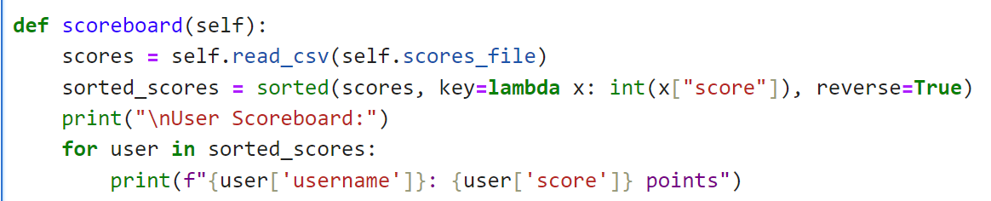
Task5
Scoreboard Implement scoreboard() method that displays all users and their scores in descending order. This will allow the library to recognize and reward active participants
2# The read_csv method is responsible for reading the contents of the CSV file and returning a list of those contents.
3# This line uses the sorted function to sort the scores list.
key=lambda x: int(x["score"]) specifies the basis for sorting.
The int function is used to convert it to an integer for proper sorting
reverse=True indicates that the order is sorted in descending order.
4# Print the uses’ name and score.

Slide 13
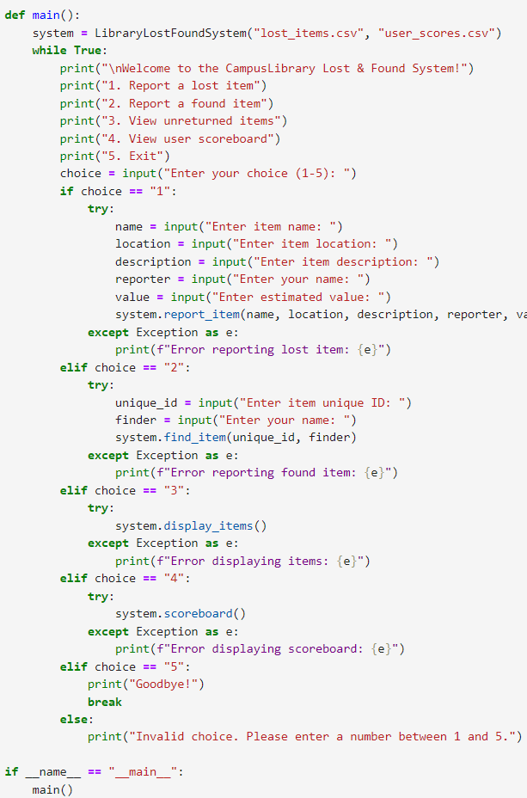
Task6: Implement a simple console-based interface for interacting with the system. This interface should:Allow users to report lost or found items;View and manage the item inventory;Display the user scoreboard.
Task6
This' main 'function is the entry point for the entire program.It first creates 'LibraryLostFoundSystem' class, and initializes the entire lost-and-found system.
An infinite loop (' while True ') is then entered, the user is then asked to enter a selection (numbers 1 to 5) and perform different actions depending on the number the user enters.
The main() and _main_ code are used to determine whether the script is running directly or is being imported as a module into another script.
If the script runs directly( '__name__' ==' __main__ '), then the 'main' function is called, and the entire lost-and-found system process begins.
If the script is imported for use elsewhere, this part of the code will not be executed, and only the classes and functions defined in the script are provided for other code to call.

Slide 14
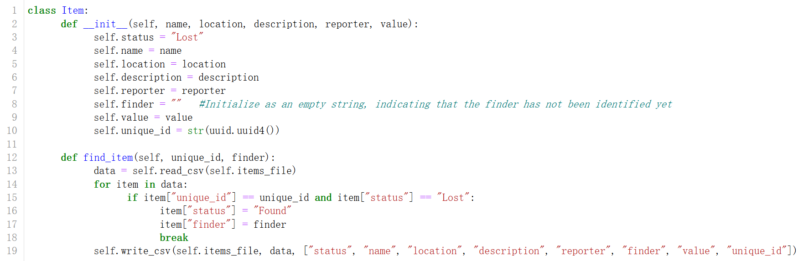
Task7
The LibraryItem class and LibraryLostSystem class allow for managing the status of lost items, including the ability to record the name of the finder. The system supports updating the item's status when it is found, capturing the finder’s name, and reflecting these changes in the CSV file.
When the item's ' unique_id ' and the number input are the same, and its status is "Lost" , it change the status of the item to "found".At the same time ,it make a note of the ’ finder’ ,and then jump out of the loop. Finally, the 'write_csv' method is called to write the updated item information back to the CSV file.

Slide 15
3
Example

Slide 16
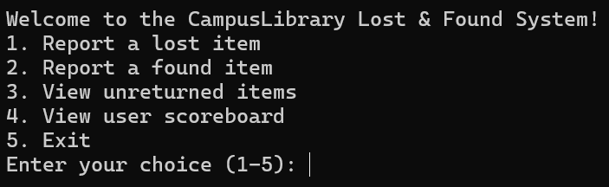
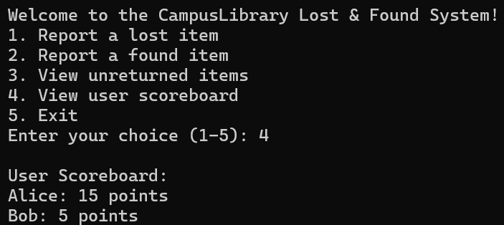
Successfully start
& viewed user scoreboard in system

Slide 17
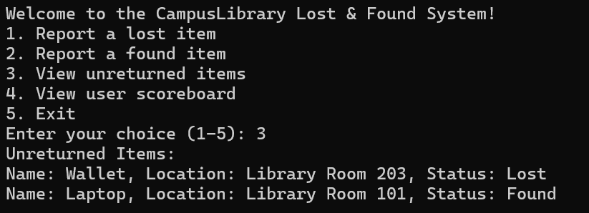
Successfully viwed unreturned item in system

Slide 18
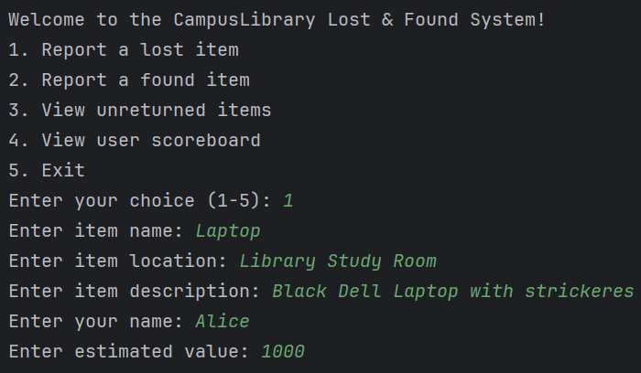
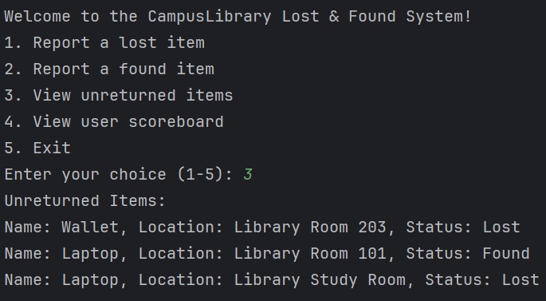
Successfully report a lost item& viewed it in system

Slide 19
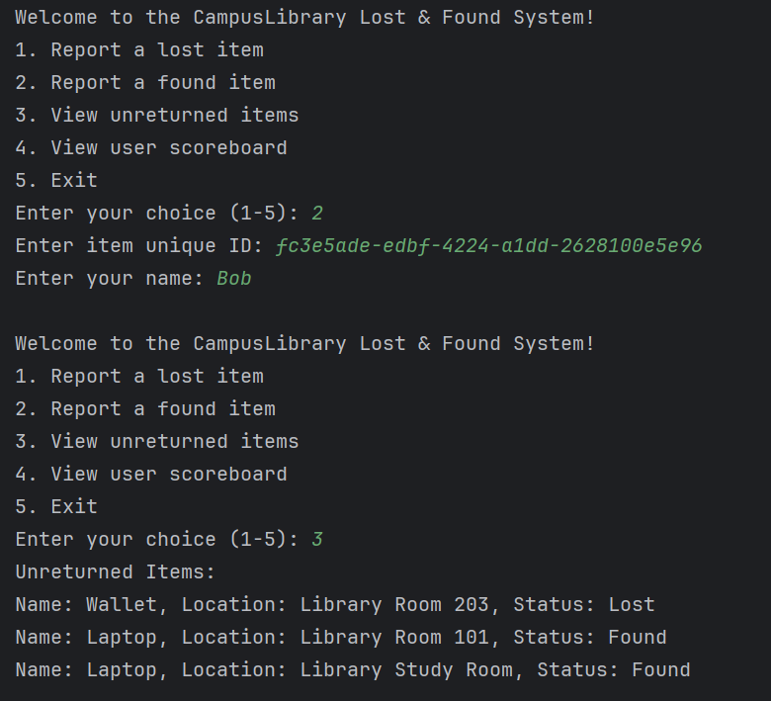
Successfully return a lost item
& viewed it in system

Slide 20
Thanks for listening
汇报人：启智设计
汇报人：小壳

